Slide 1

A Project Report ON Automatic Player Face Detection and Recognition for Players in Cricket Games
Kakinada institute of engineering & Technology 2023-2025
Under the guidance of
GUIDE NAME: Mr. G. RAM MOHAN,
M.TECH, Assoc. Professor.
Presented by
NAME: MANIKANTA KOTIPALLI
REG NO: 23B21F00H4

Slide 2
TABLE OF CONTENTS
ABSTRACT
AIM
EXISTING SYSTEM
DISADVANTAGES
PROPOSED SYSTEM
ADVANTAGES
EXTENSION WORK
SPECIFICATIONS
MODULES
ARCHITECTURE
UML DIAGRAMS
SCREENSHOTS
CONCLUSION

Slide 3
ABSTRACT
We present an innovative augmented reality cricket broadcasting application that enhances the viewing experience by displaying player information using real-time face recognition. The system employs the AdaBoost algorithm for player and face detection, utilizing a PAL-based model to accurately identify players on the field.
Trained on extensive cricket footage, the system effectively recognizes player faces under challenging conditions like occlusion, varying lighting, expressions, and poses. The high accuracy of this system enables seamless real-time player identification and data display during broadcasts.
Beyond cricket, this technology holds potential for application in other sports, offering a cutting-edge solution for enhancing sports broadcasting through automatic player detection and recognition. It details the methodology, results, and future implications of this system.

Slide 4
aim
To develop an augmented reality cricket broadcasting application that enhances viewer engagement by providing real-time player identification and personal data using advanced face recognition technology.

Slide 5
EXISTING SYSTEM
Existing face recognition systems in sports broadcasting rely on basic geometric features, such as the distance between facial landmarks like the eyes and nose, for identifying players. While these systems have been around since the 1960s and improved in the 1990s, they struggle with accuracy under varying conditions, including changes in lighting, pose, and expression.
More recently, deep learning techniques, particularly convolutional neural networks (CNNs), have enhanced the capability of these systems by enabling the recognition of faces in diverse environments. Despite these advancements, current systems still face challenges with occlusions and require further development for real-time sports applications.

Slide 6
DISADVANTAGES
Low accuracy in challenging conditions.
Struggles with varying lighting and poses.
Inconsistent performance with facial expressions.
Limited effectiveness against occlusions.
Inefficiency in real-time scenarios.

Slide 7
PROPOSED SYSTEM
In this project we use combination of Linear Discriminant Analysis (LDA) and ADABOOST algorithm to detect and recognize cricket player faces. LDA will be used to extract features from the faces and then extracted features will be trained with ADABOOST algorithm to player recognition.
To detect face region we have used Viola Jones OPENCV algorithm and then detected faces will be feed to LDA and ADABOOST algorithm for further recognition. Faces trained with LDA and ADABOOST giving more accuracy compare to existing CNN and FRCNN algorithms.

Slide 8
ADVANTAGES
Enhances real-time viewer engagement.
Provides instant player identification.
Improves sports broadcasting accuracy.
Works under challenging conditions.
Reduces manual data input efforts.
Increases information accessibility for viewers.
Applicable across multiple sports.

Slide 9
EXTENSION WORK
To further enhance accuracy we have experimented with various pre-trained model but VGG19 with enhance CNN layer giving high accuracy compare to propose algorithm. Enhanced VGG19-CNN contains additional layer called Dropout to remove all irrelevant training features and then get trained only on relevant features to gain accuracy.

Slide 10
SPECIFICATIONS
HARDWARE:
RAM : 8 GB
Hard disc or SSD : 500 GB
Processor : Intel 3rd generation or high
SOFTWARE:
Operating system : Windows 10 or 11
Software’s : Python 3.7 or high version
Jupyter Notebook , Flask

Slide 11
MODULES
1. Dataset Creation
The dataset used for training the model includes images of cricket players captured from various sources.
The dataset comprises images under different conditions, such as:
Occlusion (players wearing helmets, sunglasses, or partial face coverage).
Non-uniform illumination (varying lighting conditions).
Pose variations (side-facing, tilted angles).
Different expressions (smiling, neutral, intense focus).
Since a publicly available dataset does not exist, some images are scraped from Google and preprocessed for training.

Slide 12
MODULES
2. Image Preprocessing
Images are resized to a fixed resolution suitable for deep learning models.
Normalization is applied to standardize pixel values.
Data augmentation techniques such as rotation, flipping, and brightness adjustments are applied to enhance generalization.
3. Face Detection Using Viola-Jones Algorithm
The Viola-Jones face detection algorithm in OpenCV is utilized to identify the face region from the input images.

Slide 13
MODULES
4. Feature Extraction Using Linear Discriminant Analysis (LDA)
LDA is used to extract distinctive features from the detected faces.
LDA projects high-dimensional facial data into a lower-dimensional space, making it easier for ADABOOST to classify.
The output of LDA represents a set of key facial features that uniquely define each player.

Slide 14
MODULES
5. Player Face Recognition Using ADABOOST
The Adaboost classifier is trained on the extracted LDA features.
Adaboost combines weak classifiers to form a strong classifier
Performance Metrics:
Achieved 91% accuracy, outperforming standard CNN-based classifiers

Slide 15
MODULES
6. Deep Learning Extension: VGG19-CNN with Dropout Layers
To improve recognition accuracy further, an enhanced VGG19 Convolutional Neural Network (CNN) model is implemented:
VGG19 architecture consists of multiple convolutional layers trained for deep feature extraction.
The model undergoes fine-tuning to focus only on relevant face features.
Performance Metrics:
Achieved 95% accuracy, making it the most effective approach.
Outperformed the LDA-Adaboost model.

Slide 16
MODULES
7. Model Compariosn
Comparison of Models:
Existing CNN Model: 86% accuracy.
LDA + ADABOOST Model: 91% accuracy.
Enhanced VGG19-CNN Model: 95% accuracy.

Slide 17
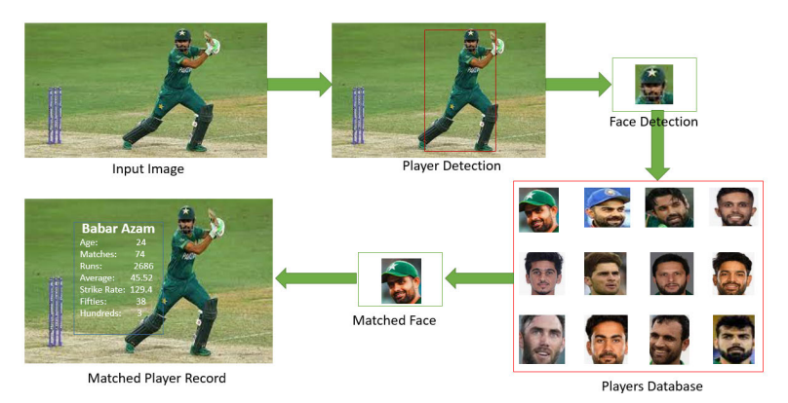
ARCHITECTURE

Slide 18
USE CASE DIAGRAM

Slide 19
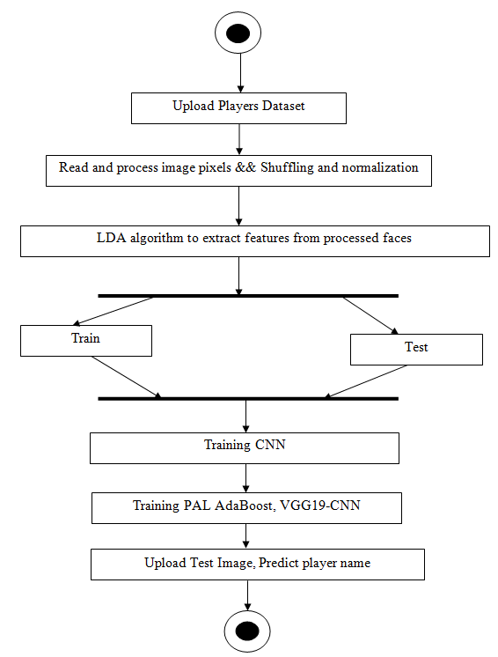
ACTIVITY DIAGRAM

Slide 20
CLASS DIAGRAM

Slide 21
COLLABORATION DIAGRAM

Slide 22
SEQUENCE DIAGRAM

Slide 23
SCREEN SHOTS

Slide 24

HOME PAGE

Slide 25

ADMIN LOGIN

Slide 26
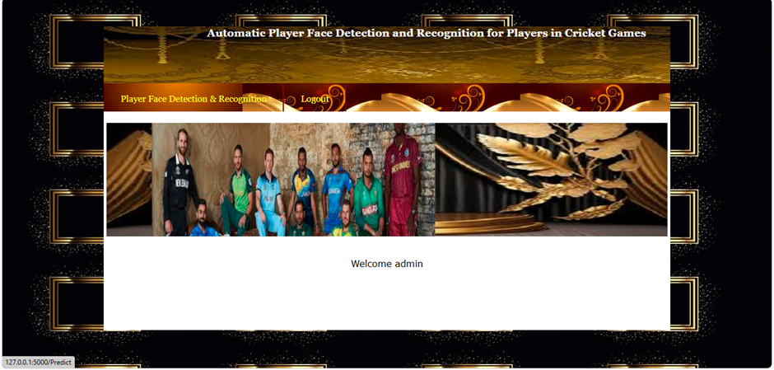
FACE DETECTION AND RECOGNITION

Slide 27
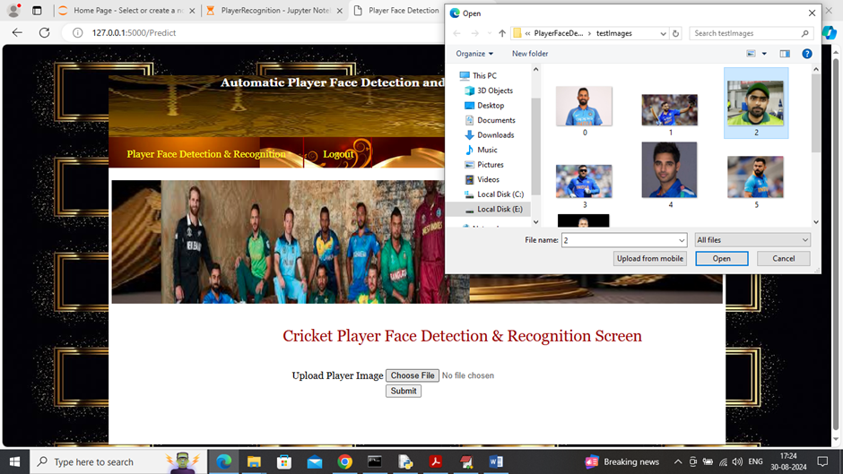
UPLOAD TEST IMAGE

Slide 28
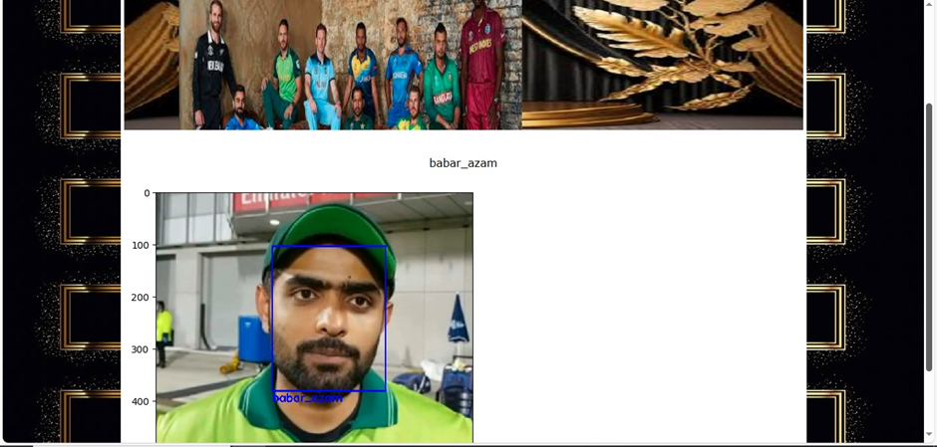
DETECTION AND RECOGNIZED BABAR_AZAM

Slide 29
CONCLUSION
This research introduces an efficient player face detection and recognition system for cricket, combining LDA, ADABOOST, and VGG19-CNN to improve accuracy. The approach ensures real-time player identification, overcoming challenges like occlusion and lighting variations.
By integrating deep learning and traditional machine learning, the system achieves high precision and scalability. The Flask-based deployment enables seamless user interaction, making it a practical solution for sports analytics and broadcasting. Future improvements may include real-time video processing and multi-angle recognition to further enhance system capabilities in live sports environments.

Slide 30
THANK YOU

